Slide 1
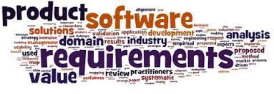
Software Requirement Engineering
Lecture # 2

Slide 2



The essential software requirement
Requirements from the customer’s perspective
Good practices for requirements engineering
The business analyst

Slide 4
Content
The Essential Software Requirement
▫ Software requirements
🞄 Some interpretations of ”requirement”
🞄 Levels and types of requirements
🞄 Working with the three levels

Slide 5
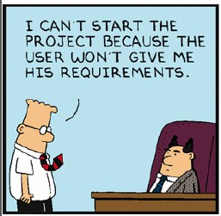
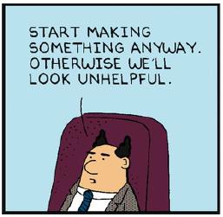
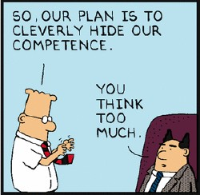
Where are the requirements?

Slide 6

Perceptions, communication patterns and interests…

Slide 7
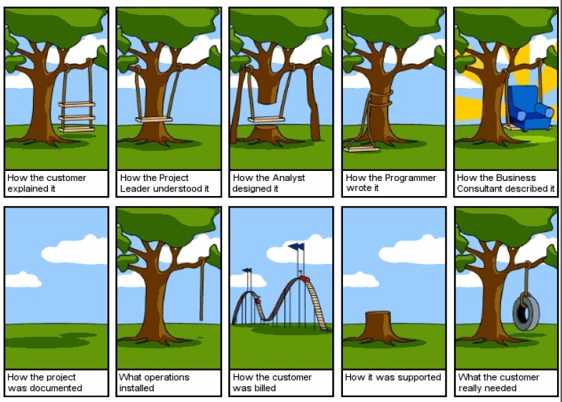

Slide 8
Why is RE important
Errors made during the requirements stage account for 40 to 60 percent of all defects found in a software project (Davis 1993; Leffingwell 1997).

Slide 9
Why do we care?
The most common reasons for project failures are not technical.
Reasons for project failure
*1. Lack of User Input 12.8%
*2. Incomplete Requirements & Specifications 12.3%
*3. Changing Requirements & Specifications 11.8%
4. Lack of Executive Support 7.5%
5. Technology Incompetence 7.0%
6. Lack of Resources 6.4%
*7. Unrealistic Expectations 5.9%
8. Unclear Objectives 5.3%
9. Unrealistic Time Frames 4.3%
10. New Technology 3.7%
Other 23.0%
Those marked with an asterisk are directly related to requirements.
Standish Group’s Chaos Report (1995)
Notes:
The data is drawn from surveys conducted by the Standish Group in 1995 and 1996, and shows the percentage of projects that
stated various reasons for project failure. Those marked with an asterisk are directly related to requirements.

Slide 10
Why do we care?
Project Success Factors % of Responses
1. User Involvement 15.9%
2. Executive Management Support 13.9%
3. Clear Statement of Requirements 13.0%
4. Proper Planning 9.6%
5. Realistic Expectations 8.2%
6. Smaller Project Milestones 7.7%
7. Competent Staff 7.2%
8. Ownership 5.3%
9. Clear Vision & Objectives 2.9%
10. Hard-Working, Focused Staff 2.4%
Other 13.9%
Standish Group’s Chaos Report (1995)

Slide 11
Some key questions
What are requirements?
How do stakeholders define requirements?
How are requirements documented?
Is there a process we can follow?

Slide 12
–Definitions –

Slide 13
IEEE-Standard 610.12 (1990)
A requirement is:
“A condition or capability needed by a user(be it person or system) to solve a problem or achieve an objective.”
“A condition or capability that must be met or possessed by a system or system component to satisfy a contract, standard, specification, or other formally imposed document.”
A documented representation of a condition or capability as in (1) or (2).

Slide 14
Requirement: A definition
According to Ian Sommerville and Pete Sawyer (1997): :
▫ “Requirements are a specification of what should be implemented. They are descriptions of how the system should behave, or of a system property or attribute. They may be a constraint on the development process of the system.”

Slide 15
Requirement: A definition
According to Wiegers & Beatty (2013):
▫ “[A requirement is a] statement of a customer need or objective, or of a condition or capability that a product must possess to satisfy such a need or objective. A property that a product must have to provide value to a stakeholder.”

Slide 17
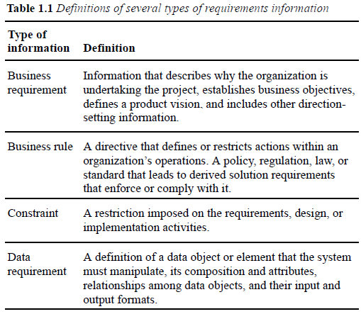
Types of Requirements Information

Slide 18
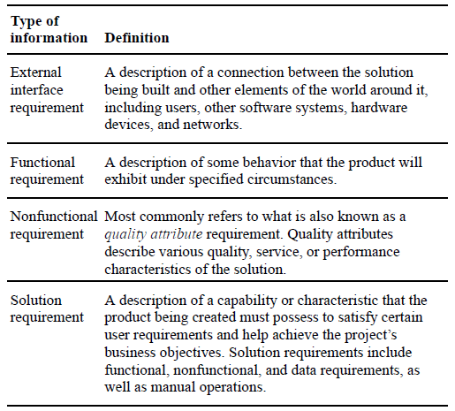

Slide 19
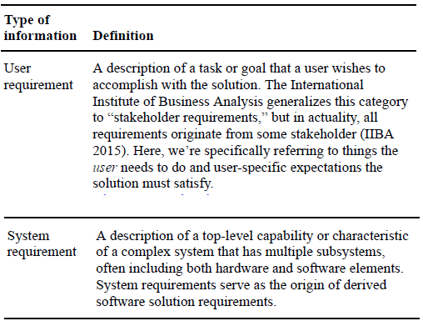

Slide 20
Levels of software requirements
It comprises of three main parts:
▫ Business Requirements
▫ User Requirements
▫ Functional Requirements

Slide 21
Levels of Software Requirements
Business Requirements
▫ “A set of information that describes a business need that leads to one or more projects to deliver a solution and the desired ultimate business
outcomes. The business requirements include business opportunities, business objectives, success metrics, a vision statement, and scope and
limitations.”

Slide 22
Levels of Software Requirements
User Requirements
▫ “A goal or task that specific classes of users must be able to perform with a system, or a desired product attribute. Use cases, user stories, and scenarios are common ways to represent user requirements.”
▫ The domain of user requirements also includes descriptions of product attributes or characteristics that are important to user satisfaction.

Slide 23
Levels of Software Requirements
Functional Requirements
▫ “A description of a behavior that a software system will exhibit under specific conditions.”
▫ They describe what the developers must implement to enable users to accomplish their tasks (user requirements), thereby satisfying the business requirements.
▫ This alignment among the three levels of requirements is essential for project success.

Slide 24
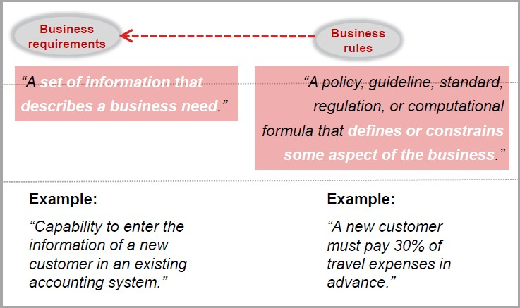
Origins of / influences from…

Slide 25
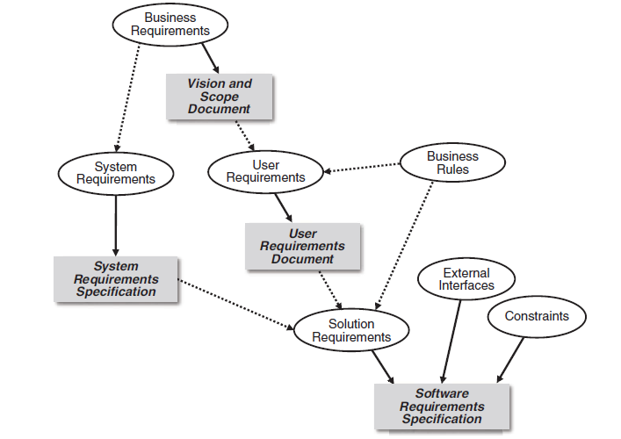
Origins of / influences from…
FIGURE shows Relationships among several types of requirements information.
Solid arrows mean “are stored in”; dotted arrows mean “are the origin of” or “influence.”

Slide 26
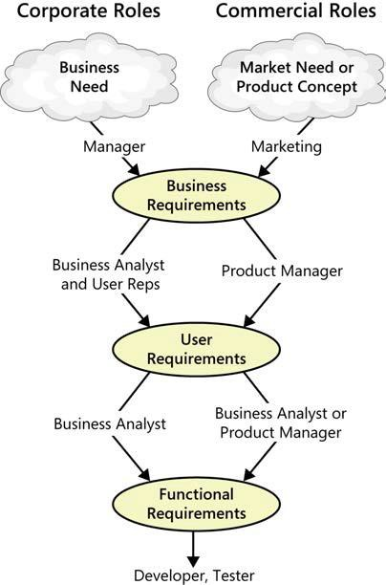
Working with the three levels
Figure illustrates how various stakeholders might participate in eliciting the three levels of requirements.

Slide 27
Requirements development and management

Slide 28
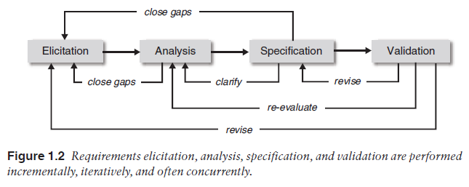
Requirements development

Slide 29
Summary
The Essential Software Requirement
▫ Software requirements
🞄 Some interpretations of ”requirement”
🞄 Levels and types of requirements
🞄 Working with the three levels

